Slide 1
Digital Logic III. Sequential Circuits
Jalal Kawash

Slide 2
Outline
Digital Logic III
Sequential Circuits
Introduction
Types of Sequential Circuits
Clocks
Basic Memory Circuits
Latches
Flip-Flops
Synchronous Sequential Circuits
Finite State Machines

Slide 3
Introduction
Digital Logic III
Sequential Circuits
Section 1

Slide 4
Section 1 Objectives At the end of this section you will
Digital Logic III
Sequential Circuits
Understand the two types of sequential circuits
Understand clock signals

Slide 5
Combinational Circuits
A combinational circuit is a logic circuit whose output is solely determined by the inputs
Combinational Circuit
n
inputs
m
outputs
…
…

Slide 6
Sequential Circuits
Unlike a combinational circuit, the output of a sequential circuit at time t can affect the circuits output at time t+1

Slide 7
Sequential Circuits
inputs
Combinational Circuit
outputs
Memory

Slide 8
Types of Sequential Circuits
Synchronous: Employ clock signals
Clock signals affect memory at discrete time
Also called “clocked”
Asynchronous: Do not employ clocks
Rely on signal propagation delay to affect memory
Harder to design
In the course, I will only talk about synchronous circuits

Slide 9
Synchronous Sequential Circuits
inputs
Combinational Circuit
outputs
Memory
Clock

Slide 10
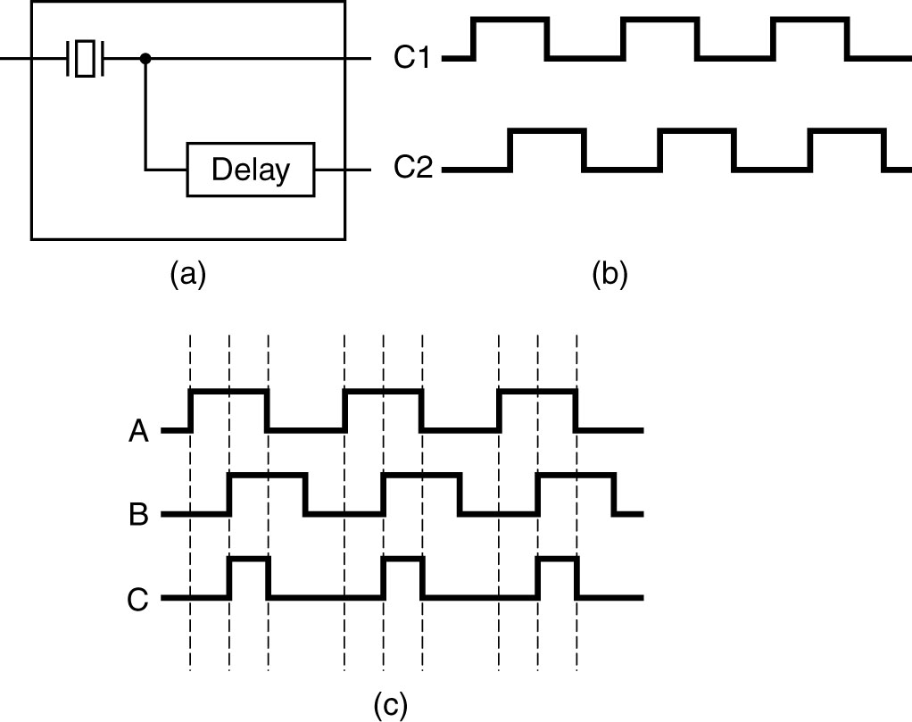
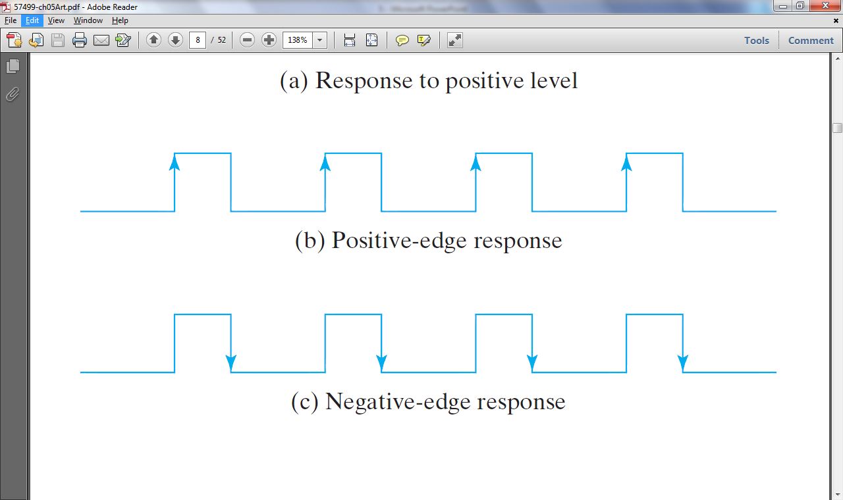
Clocks
A clock is a device that pulses at regular intervals
Synchronous sequential Circuits can be:
level-triggered: Memory is activated during a level
E.g: during the high level
here
edge-triggered: Memory is activated when signal changes
E.g: from 0 to 1 (positive edge) or 1 to 0 (negative edge)
Used more

Slide 11
Basic Memory Circuits
Digital Logic III
Sequential Circuits
Section 2

Slide 12
Section 2 Objectives At the end of this section you will
Digital Logic III
Sequential Circuits
Build 1-bit memory circuits
Understand latches
Realize problems with latches
Build flip-flops from latches
Construct higher-capacity registers from flip-flops

Slide 13
Basic Memory Circuits
Digital Logic III
Sequential Circuits
Section 2
Latches

Slide 14
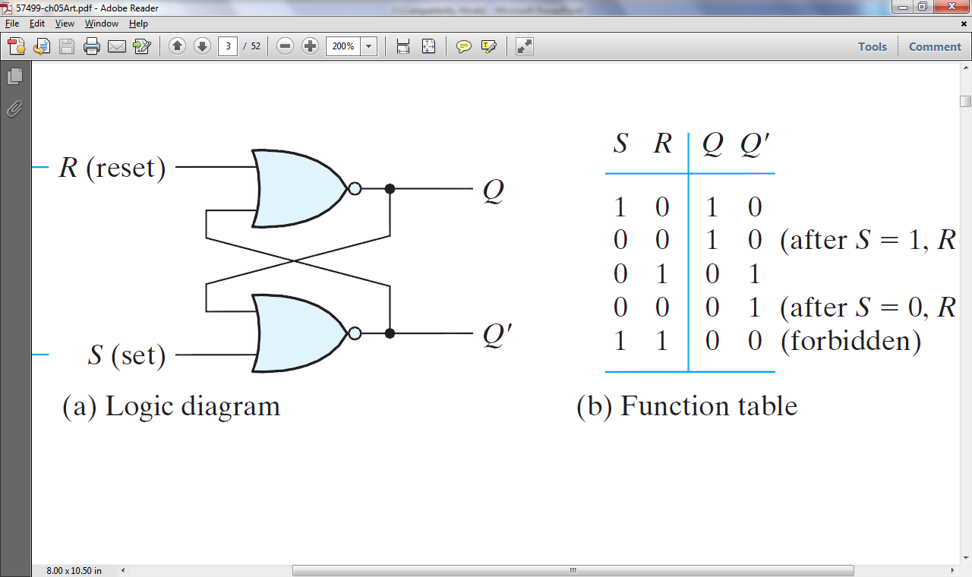
Latches
A latch is a level-triggered, single-bit memory
The Set-Rest (SR) latch:
R
Q
Q’
S

Slide 15
NOR Truth Table
x | y | x+y | (x+y)’
0 | 0 | 0 | 1
0 | 1 | 1 | 0
1 | 0 | 1 | 0
1 | 1 | 1 | 0

Slide 16
Setting the latch, S = 1, R = 0 (memory = Q = 1)
R
0
1
Q
0
Q’
0
S
1

Slide 17
Resetting the latch, S = 0, R = 1 (memory = Q = 0)
R
1
0
Q
0
1
Q’
S
0

Slide 18
S = R = 0?
R
0
Q
Q’
S
0
Behaviour depends on previous state, Q

Slide 19
When Q = 1
R
0
Q
1
0
No Change
1
Q’
0
S
0

Slide 20
When Q = 0
R
0
Q
0
1
No Change
0
Q’
1
S
0

Slide 21
S = R = 1?
R
1
0
Q
Prohibited
Q’
0
S
1
Contradicts requirement that Q and Q’ are opposites

Slide 22
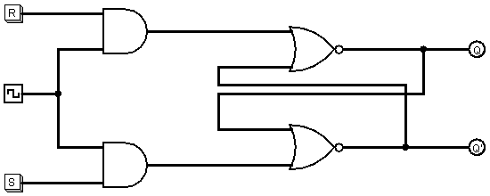
Clocked SR
Q
Q’
Source: DL3.circ (Clocked-SR)
Demo

Slide 23
Clocked SR
This is a positive-level triggered latch
When Clock is 0, R & S have no effect

Slide 24
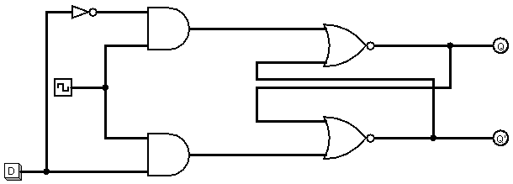
D-Latch
There is no S=R=1 state
Q
Q’
D-latch demo
Source: DL3.circ (D-latch)

Slide 25
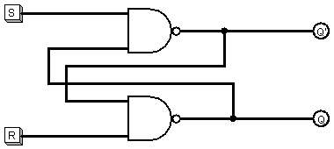
SR Latch with NAND Gates
Source: DL3.circ (NAND SR-Latch)

Slide 26
SR-Latch Comparison
NOR
NAND
R=S=0 has no effect
R=S=1 prohibited
R=S=1 has no effect
R=S=0 prohibited

Slide 27
Problem With Latches
Latches are level-triggered, so circuits can become unreliable

Slide 28
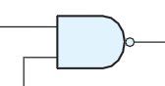
Why unreliable?
1
1
0
?
0
1
0
D latch
1
Q
0
1
0
D
clock
clock

Slide 29
Basic Memory Circuits
Digital Logic III
Sequential Circuits
Section 2
Flip-Flops

Slide 30
Flip-Flops
Flip-flops are also 1-bit memory circuits
They are edge triggered
They solve the unreliability issue with sequential circuits that employ latches
Flip-flops are the basis for registers

Slide 31

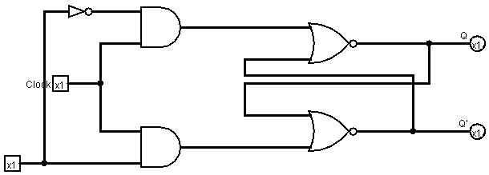
D Flip-Flop (Master-Slave)
D-Latch 2
Source: DL3.circ (D Flip Flop, D-Latch 2

Slide 32
D Flip-Flop (Master-Slave)
V
D
V
V
D
Clk
Clk
1
0
Slave latch is not affected
Q does not change

Slide 33
D Flip-Flop (Master-Slave)
No change
D
V
D
V
V
Clk
Clk
0
1
Master latch is not affected
Q changes to V
This is a negative-edge triggered flip-flop

Slide 34
Symbols for D-Flip-Flops
D
D
Positive-edge
Negative-edge

Slide 35
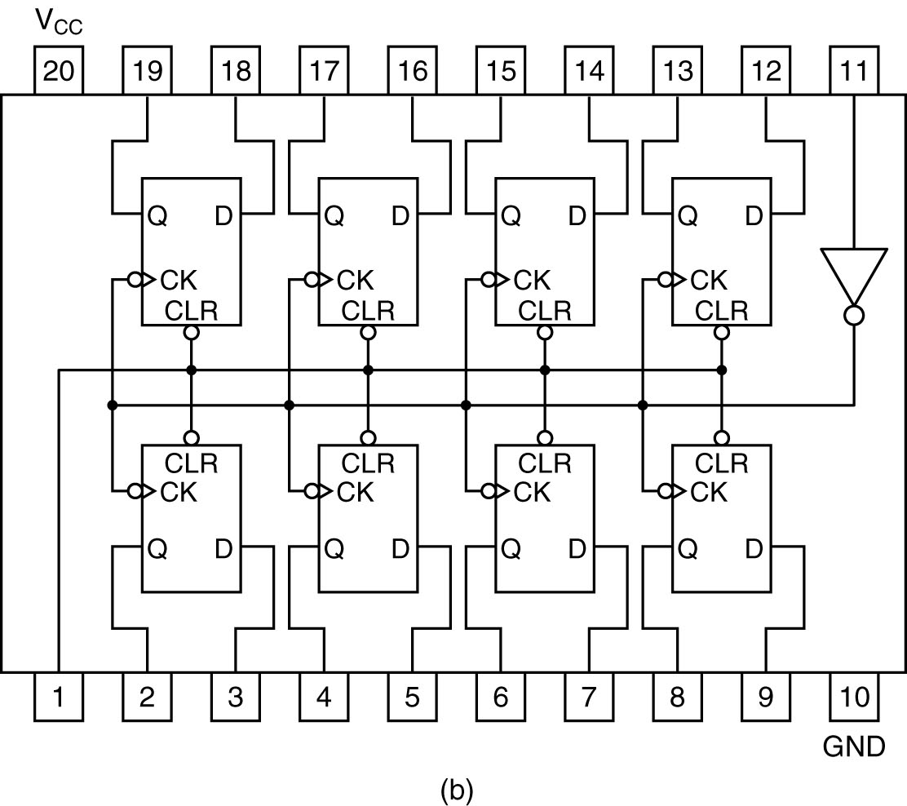
8-bit Register
Works as a signal amplifier
Octal flip-flop

Slide 36
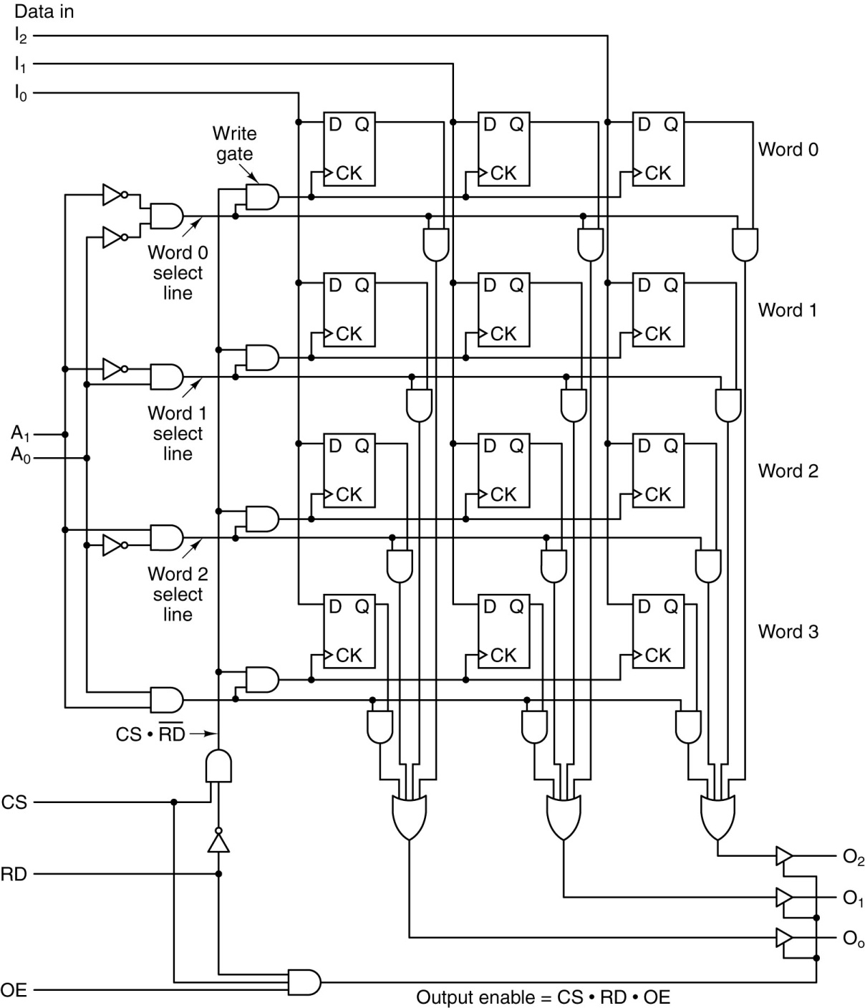
Memory Organization
Logic diagram for a
4 x 3 memory.
Each row is one of the four 3-bit words.
Decoder
Chip select
Read (1) – Write (0)
Output Enabled

Slide 37
Writing
Logic diagram for a
4 x 3 memory.
Each row is one of the four 3-bit words.
1
0

Slide 38
Reading
Logic diagram for a
4 x 3 memory.
Each row is one of the four 3-bit words.
1
1
1
From Tanenbaum, Structured Computer Organization, Fifth Edition, (c) 2006 Pearson Education, Inc. All rights reserved.

Slide 39
Finite State Machines
Digital Logic III
Sequential Circuits
Section 2

Slide 40
Section 3 Objective At the end of this section you will
Digital Logic III
Sequential Circuits
Design sequential circuits as Finite State Machines

Slide 41
Finite State Machines
Hardware is typically designed as an FSM
An FSM is equivalent to an synchronous DL circuit
FSM
A finite set of states
A set of transitions
Example: A simple Air-conditioning system

Slide 42
Simple Air-Conditioning System
Can be only controlled by a remote device
Device has two buttons: POWER and SPEED
AC has two fan speeds: LOW and HIGH
When turned on it always starts in LOW
POWER switches it ON and OFF
SPEED toggles between both speeds
When on LOW, goes to HIGH
When on HIGH goes to LOW

Slide 43
FSM
HIGH
POWER
OFF
SPEED
SPEED
SPEED
POWER
LOW
POWER

Slide 44
HIGH
POWER
OFF
SPEED
SPEED
SPEED
POWER
LOW
POWER
POWER | SPEED | Current State | Next State
1
0
OFF
LOW
1
0
LOW
OFF
1
0
HIGH
OFF
0
1
OFF
OFF
0
1
LOW
HIGH
0
1
HIGH
LOW

Slide 45
POWER | SPEED | Current State | Next State
1 | 0 | OFF | LOW
1 | 0 | LOW | OFF
1 | 0 | HIGH | OFF
0 | 1 | OFF | OFF
0 | 1 | LOW | HIGH
0 | 1 | HIGH | LOW
0 | 0 | OFF | OFF
0 | 0 | LOW | LOW
0 | 0 | HIGH | HIGH

Slide 46
POWER | SPEED | Current State | Next State
1 | 0 | OFF | LOW
1 | 0 | LOW | OFF
1 | 0 | HIGH | OFF
0 | 1 | OFF | OFF
0 | 1 | LOW | HIGH
0 | 1 | HIGH | LOW
0 | 0 | OFF | OFF
0 | 0 | LOW | LOW
0 | 0 | HIGH | HIGH
Replace:
OFF by 00
LOW by 01
HIGH by 10

Slide 47
POWER | SPEED | Current State | Next State
1 | 0 | 00 | LOW
1 | 0 | LOW | 00
1 | 0 | HIGH | 00
0 | 1 | 00 | 00
0 | 1 | LOW | HIGH
0 | 1 | HIGH | LOW
0 | 0 | 00 | 00
0 | 0 | LOW | LOW
0 | 0 | HIGH | HIGH
Replace:
OFF by 00
LOW by 01
HIGH by 10

Slide 48
POWER | SPEED | Current State | Next State
1 | 0 | 00 | LOW
1 | 0 | LOW | 00
1 | 0 | HIGH | 00
0 | 1 | 00 | 00
0 | 1 | LOW | HIGH
0 | 1 | HIGH | LOW
0 | 0 | 00 | 00
0 | 0 | LOW | LOW
0 | 0 | HIGH | HIGH
Replace:
OFF by 00
LOW by 01
HIGH by 10

Slide 49
POWER | SPEED | Current State | Next State
1 | 0 | 00 | 01
1 | 0 | 01 | 00
1 | 0 | HIGH | 00
0 | 1 | 00 | 00
0 | 1 | 01 | HIGH
0 | 1 | HIGH | 01
0 | 0 | 00 | 00
0 | 0 | 01 | 01
0 | 0 | HIGH | HIGH
Replace:
OFF by 00
LOW by 01
HIGH by 10

Slide 50
POWER | SPEED | Current State | Next State
1 | 0 | 00 | 01
1 | 0 | 01 | 00
1 | 0 | HIGH | 00
0 | 1 | 00 | 00
0 | 1 | 01 | HIGH
0 | 1 | HIGH | 01
0 | 0 | 00 | 00
0 | 0 | 01 | 01
0 | 0 | HIGH | HIGH
Replace:
OFF by 00
LOW by 01
HIGH by 10

Slide 51
POWER | SPEED | Current State | Next State
1 | 0 | 00 | 01
1 | 0 | 01 | 00
1 | 0 | 10 | 00
0 | 1 | 00 | 00
0 | 1 | 01 | 10
0 | 1 | 10 | 01
0 | 0 | 00 | 00
0 | 0 | 01 | 01
0 | 0 | 10 | 10
Replace:
OFF by 00
LOW by 01
HIGH by 10

Slide 52
Three inputs: two bits (P&S) from the device
And two (B&C) bits representing the state the FSM is in
P | S | AB | XY
1 | 0 | 00 | 01
1 | 0 | 01 | 00
1 | 0 | 10 | 00
0 | 1 | 00 | 00
0 | 1 | 01 | 10
0 | 1 | 10 | 01
0 | 0 | 00 | 00
0 | 0 | 01 | 01
0 | 0 | 10 | 10
Two output bits (XY) determining the next state

Slide 53
Boolean Sum of Products for X
P | S | AB | XY
1 | 0 | 00 | 01
1 | 0 | 01 | 00
1 | 0 | 10 | 00
0 | 1 | 00 | 00
0 | 1 | 01 | 10
0 | 1 | 10 | 01
0 | 0 | 00 | 00
0 | 0 | 01 | 01
0 | 0 | 10 | 10
X = P’SA’B + P’S’AB’
= P’(SA’B + S’AB’)

Slide 54
Boolean Sum of Products for Y
P | S | AB | XY
1 | 0 | 00 | 01
1 | 0 | 01 | 00
1 | 0 | 10 | 00
0 | 1 | 00 | 00
0 | 1 | 01 | 10
0 | 1 | 10 | 01
0 | 0 | 00 | 00
0 | 0 | 01 | 01
0 | 0 | 10 | 10
Y = PS’A’B’ + P’SAB’ + P’S’A’B
=S’A’ (PB’ + P’B) + P’SAB’
=S’A’ (P ⊕ B) + P’SAB’

Slide 55
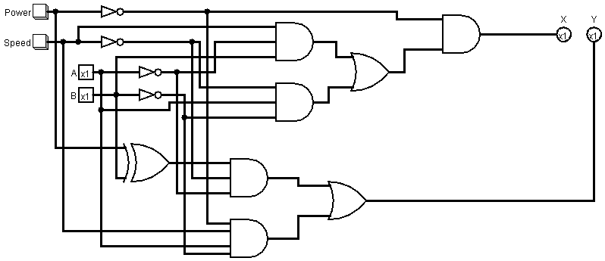
The Combinational Circuit
Source:DL3.circ (AC Combinational)

Slide 56
A Sequential Circuit?
Not yet
The FSM needs to ‘remember’ current state to be used to determine next state
Store X and feed it back to B
Store Y and feed it back to C

Slide 57
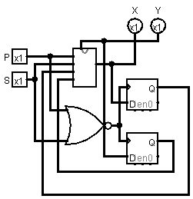
The Sequential Circuit
AC
Comb
Source: LD3.circ (AC Sequential)

Slide 58
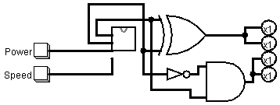
The System
x | y | F1 | F2 | F3 | F4
0 | 1 | 1 | 1 | 0 | 0
1 | 0 | 1 | 1 | 1 | 1
F1 = F2 = x⊕y
F3 = F4 = xy’
High Speed
Low Speed
x⊕y
F1
x
y
F2
F3
F4
xy’
AC Sequential
Demo
Source: LD3.circ (AC System)

Slide 59
Timer Example
10
TICK
00
TICK
TICK
01

Slide 60
A | B | Tick | A_{new} | B_{new}
0 | 0 | 1 | 0 | 1
0 | 1 | 1 | 1 | 0
1 | 0 | 1 | 0 | 0
0 | 0 | 0 | 0 | 0
0 | 1 | 0 | 0 | 1
1 | 0 | 0 | 1 | 0
10
TICK
00
TICK
TICK
01
A_{new} = A’BT + AB’T
B_{new} = A’B’T + A’BT’
= A’(B⊕T)

Slide 61
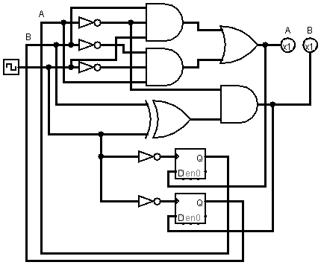
Demo
Source: LD3.circ (Timer)

